Slide 1



EXTRA RESOURCE
HTML5
New markups and attributes
Notes:
© SUPINFO International University - http://www.supinfo.com
SUPINFO vous permet de partager ce document
Vous êtes libre de :
Partager — reproduire, distribuer et communiquer ce document Remixer — modifier ce document
A condition de respecter les règles suivantes :
Indication obligatoire de la paternité — Vous devez obligatoirement préciser l’origine « SUPINFO » du document au début de celui-ci de la même manière qu’indiqué par SUPINFO International University – Notamment en laissant obligatoirement la première et la dernière page du document, mais pas d'une manière qui suggérerait que SUPINFO International University vous soutiennent ou approuvent votre utilisation du document, surtout si vous le modifiez. Dans ce dernier cas, il vous faudra obligatoirement supprimer le texte « SUPINFO Official Document » en tête de page et préciser notamment la page indiquant votre identité et les modifications principales apportées.
En dehors de ces dispositions, aucune autre modification de la première et de la dernière page du document n’est autorisée.
NOTE IMPORTANTE : Ce document est mis à disposition selon le contrat CC-BY-NC-SA Creative Commons disponible en ligne http://creativecommons.org/licenses ou par courrier postal à Creative Commons, 171 Second Street, Suite 300, San Francisco, California 94105, USA modifié en ce sens que la première et la dernière page du document ne peuvent être supprimées en cas de reproduction, distribution, communication ou modification. Vous pouvez donc reproduire, remixer, arranger et adapter ce document à des fins non commerciales tant que vous respectez les règles de paternité et que les nouveaux documents sont protégés selon des termes identiques. Les autorisations au-delà du champ de cette licence peuvent être obtenues à support@supinfo.com.
© SUPINFO International University – EDUCINVEST - Rue Ducale, 29 - 1000 Brussels Belgium . www.supinfo.com

Slide 2

HTML5 - New markups
Course objectives
By completing this course, you will be able to:
Use new semantic markups
Validate form fields without JavaScript
Use new form input types
Play media resources without plugins
Make accessible widgets thanks to ARIA
Structure your data markup with Microdatas

Slide 3


HTML5 - New markups
Course topics
Course’s plan:
Semantic Markups
Web Form
Media Markups
ARIA
Microdata

Slide 4

Semantic markups
HTML5 - New markups

Slide 5

Semantic markups
Presentation
Semantic elements describe their meaning or purpose clearly to the browsers
With HTML5, no more overuse of the div tag to define a division or a section
Doesn’t tell us anything about its content
Doesn’t convey any clear meaning

Slide 6
Semantic markups
Semantic
Most websites have some common uses of generic blocks:
<div id="header">
<div id="nav">
<div class="article">
<div id="sidebar">
<div class="section">
<div id="footer">

Slide 7
Semantic markups
Semantic
HTML5 introduces the following new markups:
<header>
<nav>
<article>
<aside>
<section>
<footer>

Slide 8
<body>
<header><!-- Header content --></header>
<article>
<section>
<!-- Section content -->
</section>
<section>
<!-- Other section content -->
</section>
</article>
<aside>
<!-- Aside content -->
</aside>
<footer><!-- Footer content --></footer>
</body>
Semantic Example

Slide 9
Semantic markups
Section
The section element represents a generic section of a document
A chapter for example
<section>
<h1>Chapter 2 : Basic HTML tags</h1>
<p>
HTML markup consists of several key components, including elements […], character-based data types, character references and entity references
</p>
</section>

Slide 10
Semantic markups
Section
The section element is not a generic container element
Use div when an element is needed only for styling purposes or as a convenience for scripting
Use article when it would make sense to syndicate the contents of the element

Slide 11
Semantic markups
Article
The article element represents a self-contained composition independently distributable or reusable
News
Blog posts
…
<article id="comment-6">
<header>
<h4>John Doe</h4>
</header>
<p>Very good course ;-)</p>
</article>

Slide 12
Semantic markups
Nav
The nav element represents a section of navigation links
<nav>
<h1>Navigation</h1>
<ul>
<li><a href="/">Home</a></li>
<li><a href="/about.html">About</a></li>
</ul>
</nav>

Slide 13
Semantic markups
Header
The header element represents the header of a section
<header>
<h1>Introduction to HTML5</h1>
<p class="author-line">By John Doe</p>
</header>

Slide 14
Semantic markups
Footer
The footer element represents a footer for its nearest ancestor sectioning content
<footer>
<p>© 2012 SUPINFO International University</p>
</footer>

Slide 15
Semantic markups
Address
The address element represents the contact information for its nearest article or body element ancestor
<footer>
<address>
For more details, contact
<a href="mailto:js@example.com">John Smith</a>.
</address>
<p><small>© Copyright 2042 Plop Corp.</small></p>
</footer>

Slide 16
Semantic markups
Hgroup
The hgroup element represents the heading of a section
Used to group a set of h1–h6 elements when the heading has multiple levels
Such as subheadings, alternative titles, or taglines

Slide 17
Semantic markups
Hgroup
Example:
<hgroup>
<h1>HTML5</h1>
<h2>Or: How to design modern Web Applications</h2>
</hgroup>

Slide 18
Semantic markups
Headings and sections
The h1–h6 elements and the hgroup element are headings
The first in a section represents the heading for that section

Slide 19
Semantic markups
Headings and sections
Subsequent headings
of equal or higher rank:
start new (implied) sections
of lower rank:
start implied subsections that are part of the latter

Slide 20
Semantic markups
Semantically equivalent
<body>
<h1>HTML5</h1>
<h2>Offline Webapps</h2>
<h3>LocalStorage</h3>
<h2>New Markups</h2>
</body>
<body>
<h1>HTML5</h1>
<section>
<h1>Offline Webapps</h1>
<section>
<h1>LocalStorage</h1>
</section>
</section>
<section>
<h1>New Markups</h1>
</section>
</body>

Slide 21

WEB forms
HTML5 - New markups

Slide 22
Web Forms
Presentation
HTML5 introduce an update to the forms features found in HTML4
Add support for common needs like
Basic data typing
Simpler validation on the client side
XML submission
…

Slide 23
Web Forms
Client-side validation
Forms can be annotated to check the user's input before the form is submitted
Allows the user to avoid the wait of a validation by the server
Before HTML5, we used JavaScript to do that
Notes:
The server still has to verify the input is valid (since hostile users can easily bypass the form validation), but it allows the user to avoid the wait incurred by having the server be the sole checker of the user's input.

Slide 24
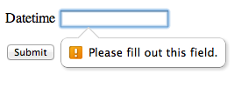
Web Forms
Client-side validation
HTML5 introduce the required annotation
With it, an input can’t be submitted until a value is given
<p>
<label>
Datetime: <input type="datetime" required />
</label>
</p>

Slide 25
Web Forms
Client-side validation
It is also possible to limit the length of the input, using the maxlength attribute
<p>
<label>
Comments: <textarea name="comments" maxlength="160"/>
</label>
</p>

Slide 26
Web Forms
Client-side validation
The pattern attribute allows you to specifies a RegEx that the control’s value has to match
<label>
Course Code: <input type="text" pattern="[1-5][A-Z]{3}"/>
</label>

Slide 27
Web Forms
Client-side validation
The min and max attributes indicate the allowed range of values for the element
<label>
Birthday: <input type="date" min="1900-12-31" />
</label>
<label>
Quantity: <input type="number" min="1" max="20" />
</label>

Slide 28
Web Forms
New input types
New input types are available :
search
tel
url
email
datetime
date
month
week
time
number
range
color
image

Slide 29
Web Forms
New input types
Each one of these new types, bring one or more of the following advantages:
A better semantic (tel, search, …)
User input validation (email, url, number, …)
New controls provided by the browser (range, …)

Slide 30

Web Forms
Search field
The search type is very similar to the text one
The difference is primarily stylistic
<p>
<label>
Search <input type="search" />
</label>
</p>

Slide 31
Web Forms
Telephone field
The tel type represents a control for editing a telephone number
The type doesn’t enforce a particular syntax to support all the format variety around the world
<p>
<label>
Telephone <input type="tel" />
</label>
</p>

Slide 32

Web Forms
Email field
The email type represents a control for editing an email address
<p>
<label>
E-mail <input type="email" />
</label>
</p>

Slide 33

Web Forms
URL field
The url type represents a control for editing a single absolute URL
<p>
<label>
URL <input type="url" />
</label>
</p>

Slide 34

Web Forms
Date field
The date type represents a control for setting the element's value to a specific date
<p>
<label>
Date <input type="date" />
</label>
</p>

Slide 35
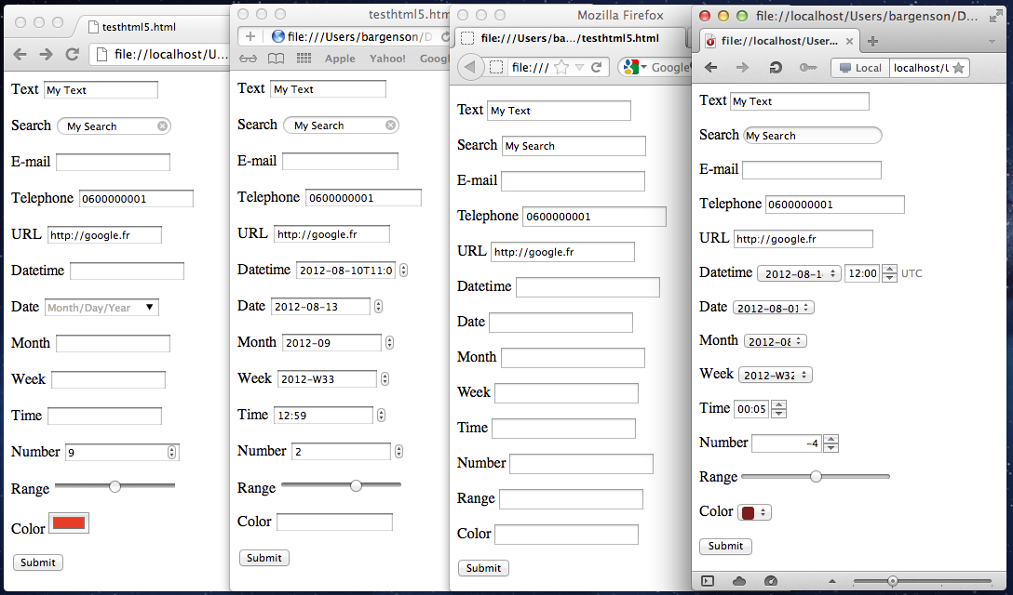





HTML5 markups
Web Forms

Slide 36
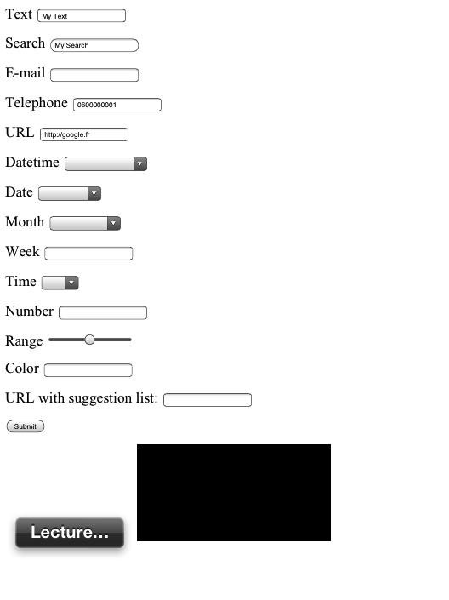
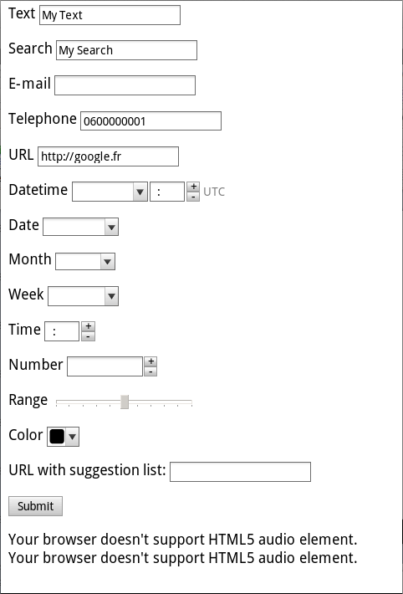


Notes:
Mobile browsers change UI in order to be more usable : sliders, custom keyboards (phone, url, datepicker), etc

Slide 37
Web Forms
Auto-completion
The new list attribute allows you to defined suggestions to the user
The attribute must refer to a datalist id containing the suggestions
You can use Ajax to update the datalist content in function of the user input if you need to

Slide 38
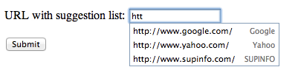
Web Forms
Auto-completion
<label>
URL with suggestion list:
<input type="url" list="hpurls">
</label>
<datalist id="hpurls">
<option value="http://www.google.com/" label="Google">
<option value="http://www.yahoo.com/" label="Yahoo">
<option value="http://www.supinfo.com/" label="SUPINFO">
</datalist>

Slide 39

Media markups
HTML5 - New markups

Slide 40
Media Markups
Audio & Video
There are more and more Audio and Video on the web
Until now, you had to use non standardize technologies like Java Applets or Flash
Need specific plug-in

Slide 41
Media Markups
Audio
The audio new element represents a sound or audio stream
Content may be provided inside the audio element
User agents should show this content to the user only if they don’t support the audio element

Slide 42

Media Markups
Audio
Example :
<audio src="http://images.wikia.com/starwars/images/3/38/UlicFalls.ogg" controls>
Your browser doesn't support the HTML5 audio element.
</audio>

Slide 43
Media Markups
Video
The new video element is used for playing videos and audio files with captions
Again, content may be provided inside the video element
User agents should show this content to the user only if they don’t support the video element

Slide 44

Media Markups
Video
Example :
<video src="myVideo.mp4" poster="movie.jpg" controls>
Your browser doesn't support the HTML5 video element.
</video>

Slide 45
Media Markups
Common attributes
audio and video have some common attributes
preload: to pre-download the media resource
autoplay: to automatically begin playback of the media resource

Slide 46
Media Markups
Common attributes
audio and video have some common attributes
controls: to ask to the user agent to provide its own set of controls
loop: to seek back to the start of the media resource upon reaching the end

Slide 47
Media Markups
Alternative sources
The source element allows to specify multiple alternative of sources to a media element
Allows the browser to choose the better source based on its media type or codec support

Slide 48
Media Markups
Alternative sources
Example:
<audio controls autoplay loop>
<source src="song.ogg" type="audio/ogg" />
<source src="song.mp3" type="audio/mpeg" />
Your browser doesn't support the HTML5 audio element.
</video>

Slide 49
Media Markups
Support for audio codecs
Browser | Version | Codec Support
Internet Explorer | 9.0+ | MP3, AAC
Firefox | 4.0+ | Ogg Vorbis, WAV
Google Chrome | 27.0+ | Ogg Vorbis, WAV, MP3, AAC, Ogg Opus
Apple Safari | 3.1+ | WAV, MP3, AAC
Opera | 10.0+ | Ogg Vorbis
Android | 2.3+ | MP3, AAC (device dependent)
iOS | 3.2+ | WAV, MP3, AAC
Blackberry | 6.0+ | MP3, AAC
Notes:
http://html5doctor.com/html5-audio-the-state-of-play/
https://developer.mozilla.org/en-US/docs/HTML/Supported_media_formats

Slide 50
Media Markups
Support for video codecs
Browser | Version | Codec Support
Internet Explorer | 9.0+ | MP4
Firefox | 4.0+ | WebM, Ogg Vorbis
Google Chrome | 6.0+ | MP4, WebM, Ogg
Apple Safari | 5.0+ | MP4
Opera | 10.6+ | WebM, Ogg
Android | 2.3+ | MP4, WebM (since 4.0)
iOS | 3.0+ | MP4
Notes:
http://www.longtailvideo.com/html5/formats/
https://developer.mozilla.org/en-US/docs/HTML/Supported_media_formats

Slide 51
Media Markups
Capture attribute
Input tags now have the capture attribute
Works with attribute type set to “file”
Allows to take picture with a camera
<input type="file" accept="image/*" capture="camera">

Slide 52
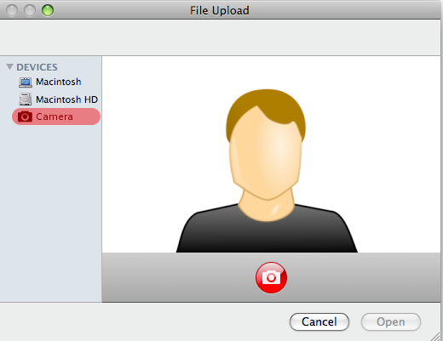
Media Markups
Capture attribute
Rendering example

Slide 53

Media Markups
Exercise (1/2)
Let’s design a simple HTML5 Media Player !
Create a simple HTML5 page with a video element and a simple form to enter a media URL
When the form is submit, the video element must play the media
Notes:
Tip: use “filetype:mp4” expression on Google to find video

Slide 54

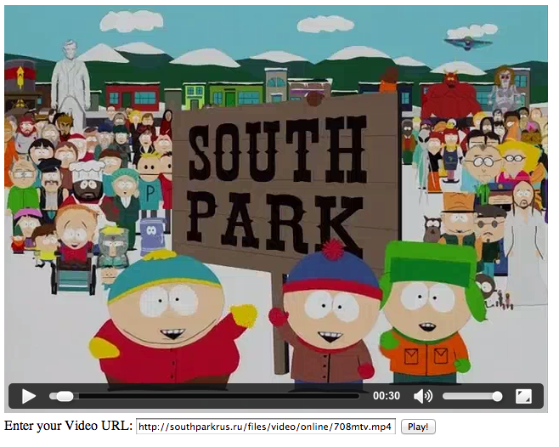
Media Markups
Exercise (2/2)

Slide 55

The end
HTML
Thanks for your attention

